Slide 1
An Integrated Terrestrial-Coastal Ocean Observation and Modeling Framework for Carbon Management Decision Support
Steven Lohrenz (U. Mass Dartmouth)
Wei-Jun Cai (U. Delaware)
Hanqin Tian (Auburn)
Ruoying He (N. Carolina State U.)
This project is supported by funding from the NASA Carbon Monitoring System Program (NX14AO73G and prior projects NNX12AB21G and NNX12AP84G).
CMS 2014 Project – CMS Science Team Meeting, November 2014

Slide 2
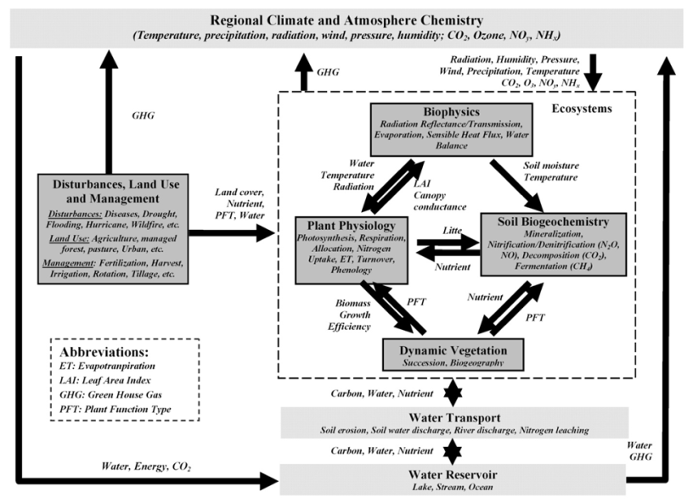
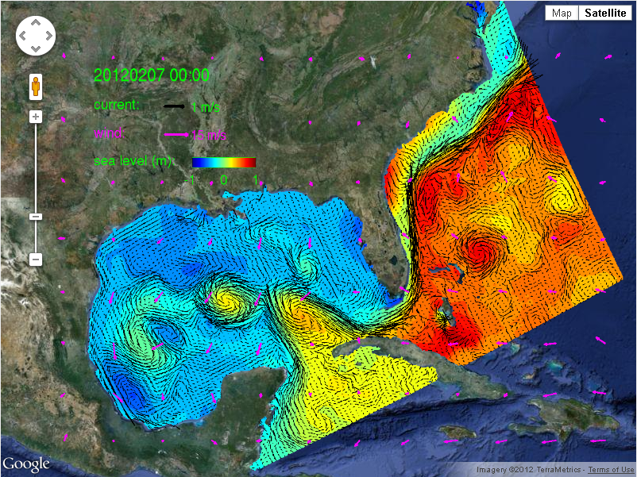
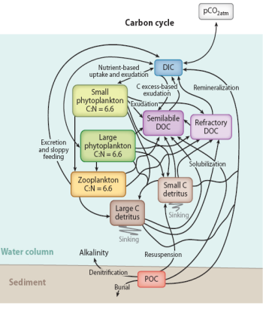
Approach: Coupled Terrestrial-Ocean Models
Effort builds on prior NASA CMS-funded research (2012)
DLEM terrestrial outputs linked to a physical-biogeochemical model to characterize coastal carbon fluxes and ecosystem dynamics
Dynamic Land Ecosystem Model used to estimate spatial and temporal patterns of delivery of water, carbon, and nitrogen and compared to data-based observations
Modeling efforts supported by field survey-based and satellite-based observations of carbon fluxes and other biogeochemical processes
Tian et al., 2010a,b; Tian et al.,2011; Tian et al.,2012 ; Zhang et al., 2012
Hyun and He (2010);
Xue et al., 2013, 2014
Hoffman et al., Ann. Rev., 2011;
Fennel et al., 2011, 2013

Slide 3
Project Objectives
Expand the spatial domain of our observational and integrated modeling approach to include the Mississippi River basin and southeastern U.S., and examine terrestrial carbon storage and fluxes including biomass and carbon stocks and land-atmosphere, land-ocean, and sea-atmosphere fluxes of carbon dioxide and methane;
Examine different LULUCF scenarios within the terrestrial domain and different climate scenarios to assess effectiveness of carbon management strategies;
Engage with other CMS projects and stakeholders to identify user needs related to carbon management and MRV activities, modify and expand the scope of information based on user feedback, and explore possible transition of prototype products to fully operational status

Slide 4
Future Applications
Land
Carbon Management
Land Use Practices
Water and Forest Management
Agriculture, Fertilizer
GHGs
Energy and Biofuels
Development
Model development will provide decision support for issues related to carbon management, water quality, and ecosystem sustainability
River Export
Coastal Margin
Air-sea flux of CO₂
Nutrients and Hypoxia
Ocean Acidification
Wetlands Loss
Coastal Restoration
Water Quality
Fisheries Habitat
Sea Level Rise
Ocean Carbon Reservoir
Long term Sequestration of Carbon?
Export

